Slide 1

Contents
Introduction
Impact of the project
Data preparation
Data manipulation and wrangling
Data loading
Data visualization
Conclusion

Slide 2
Introduction
The project deals with getting insightful information from the data collected by the Fire Department in San Francisco.
With data processing, data wrangling, and using a database to store the data, analytical dashboards were created for easy understanding through visualizations.
The dataset contains information about fire calls for service from the years 2001 to 2023.
It includes data on all emergency units that responded to these calls.
Each record in the dataset includes details such as the call, the incident, address, the unit sent and its relevant time intervals.
Tools used:
Jupyter Notebooks (Python) – for data processing and data wrangling
Neo4j (Cypher) - for data storage
Tableau – for data visualizations
Used Velero for keeping track of the project plan, resources, issues, and timesheets.

Slide 3
Project Impact
The project can be beneficial to groups interested in understanding the nature and frequency of emergency incidents reported to the San Francisco Fire Department.
Emergency responders and Fire Department personnel who want to gain insights into the types of calls they are responding to and where those calls are most frequent.
Data scientists who want to use this data as part of a larger analysis or modeling project.
Journalists or news organizations who want to report on trends or patterns in emergency incidents in San Francisco.
Residents of San Francisco who are interested in understanding the nature and frequency of emergency incidents in their neighborhoods or citywide.
Aim of the dashboards is to understand
resource allocation, preparedness,
identify areas for improvement in different departments - cities, neighborhoods, and supervising districts.

Slide 4
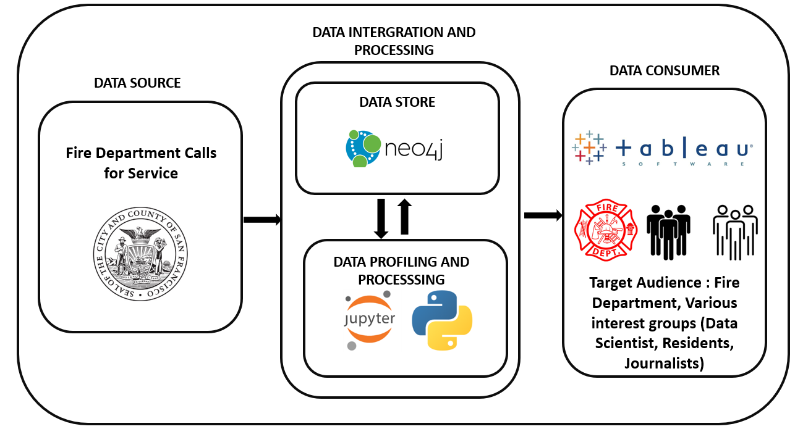
Vision Diagram

Slide 5
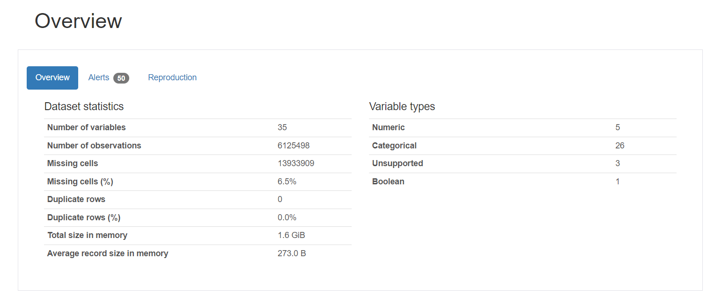
Data Preparation - Profiling
To get a basic understanding of the data pandas profiling was performed in Python (Jupyter Notebook)
Pandas Profiling is an open-source Python module with which we can quickly do an exploratory data analysis with just a few lines of code.

Slide 6
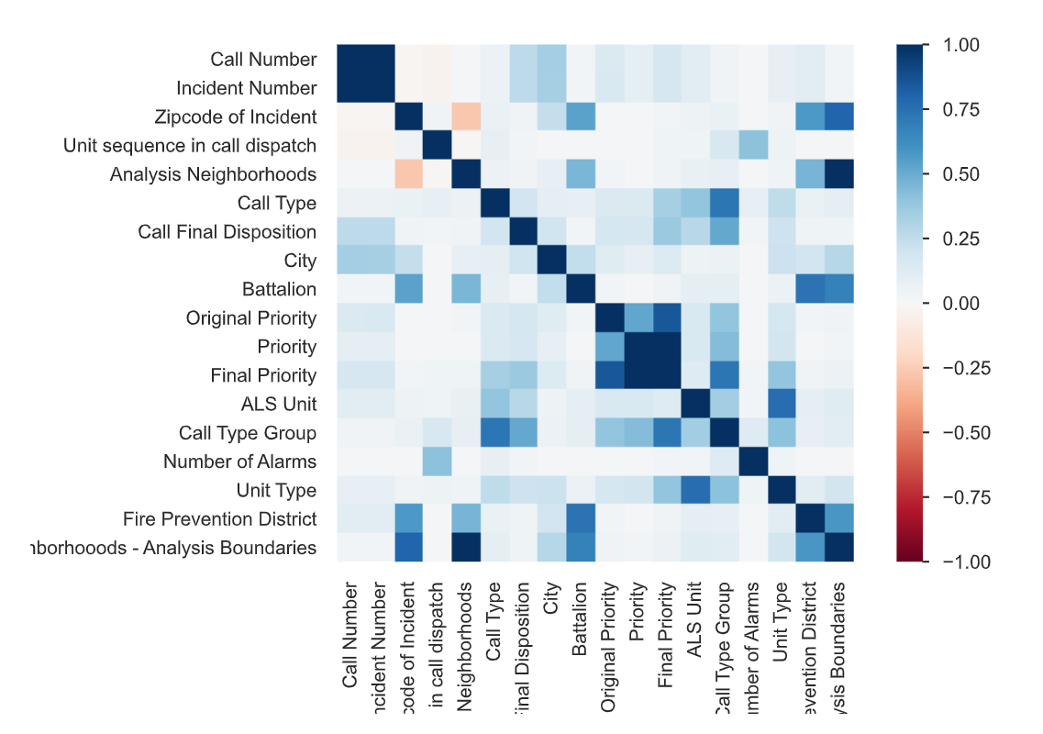
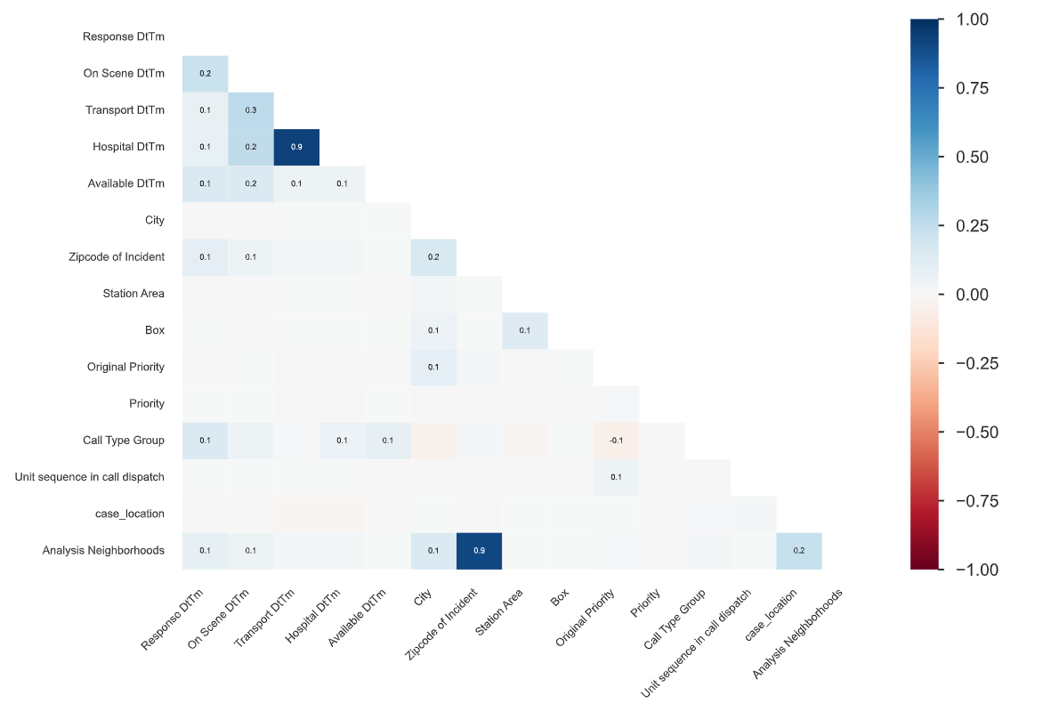
Data Preparation – Correlation and Nulls
Correlation Matrix
Null Values

Slide 7
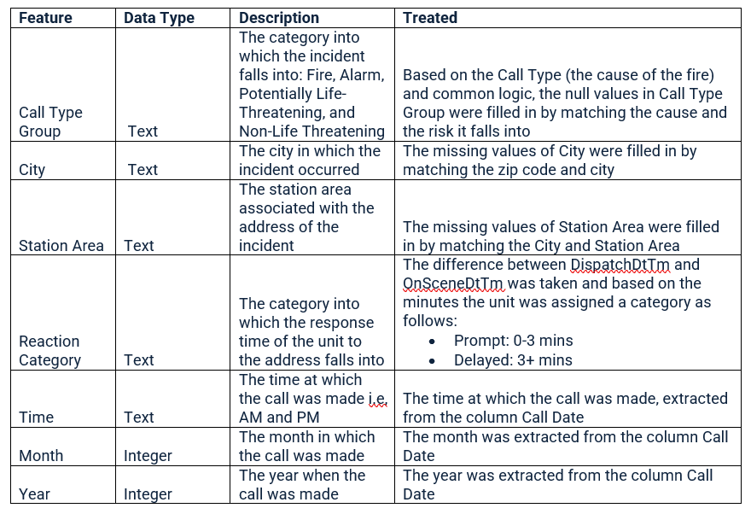
Data Manipulation and Wrangling
Out of all the columns only some were used for analysis and the following is how they were treated for null values, manipulation, and wrangling.

Slide 8
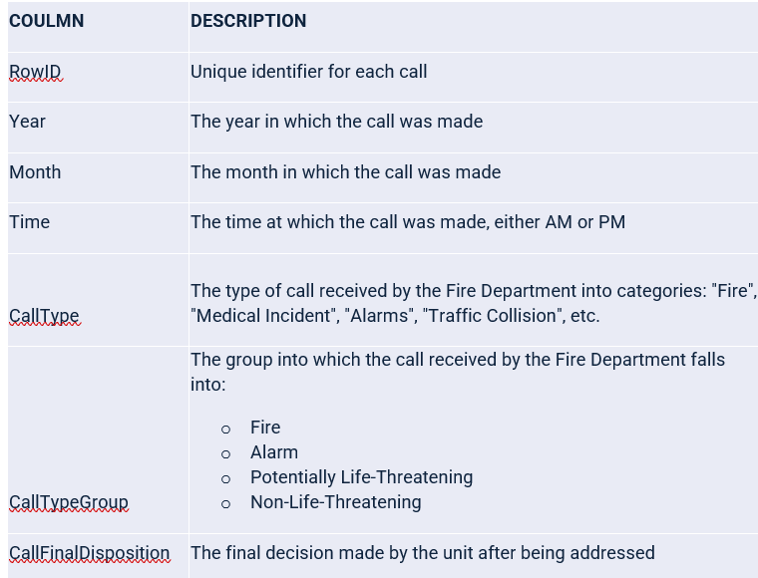
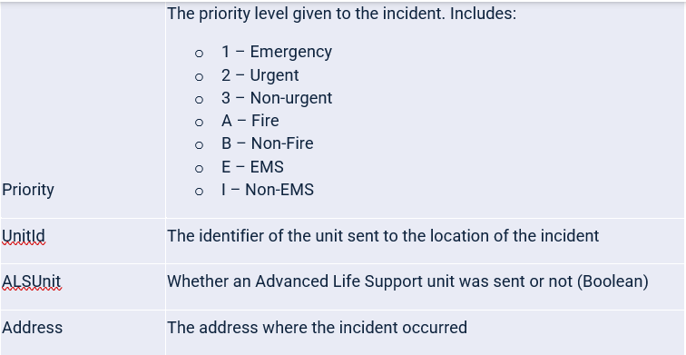
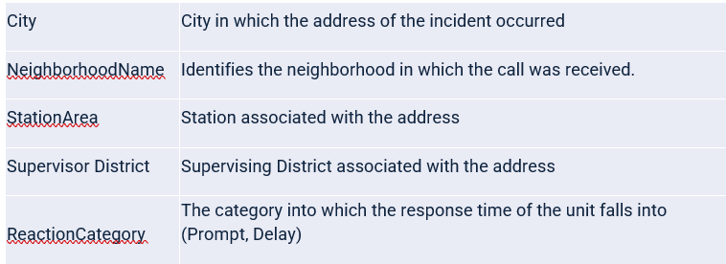
Final Dataset
After treating null values, data processing, manipulation and wrangling, these are the final columns in the dataset.

Slide 9
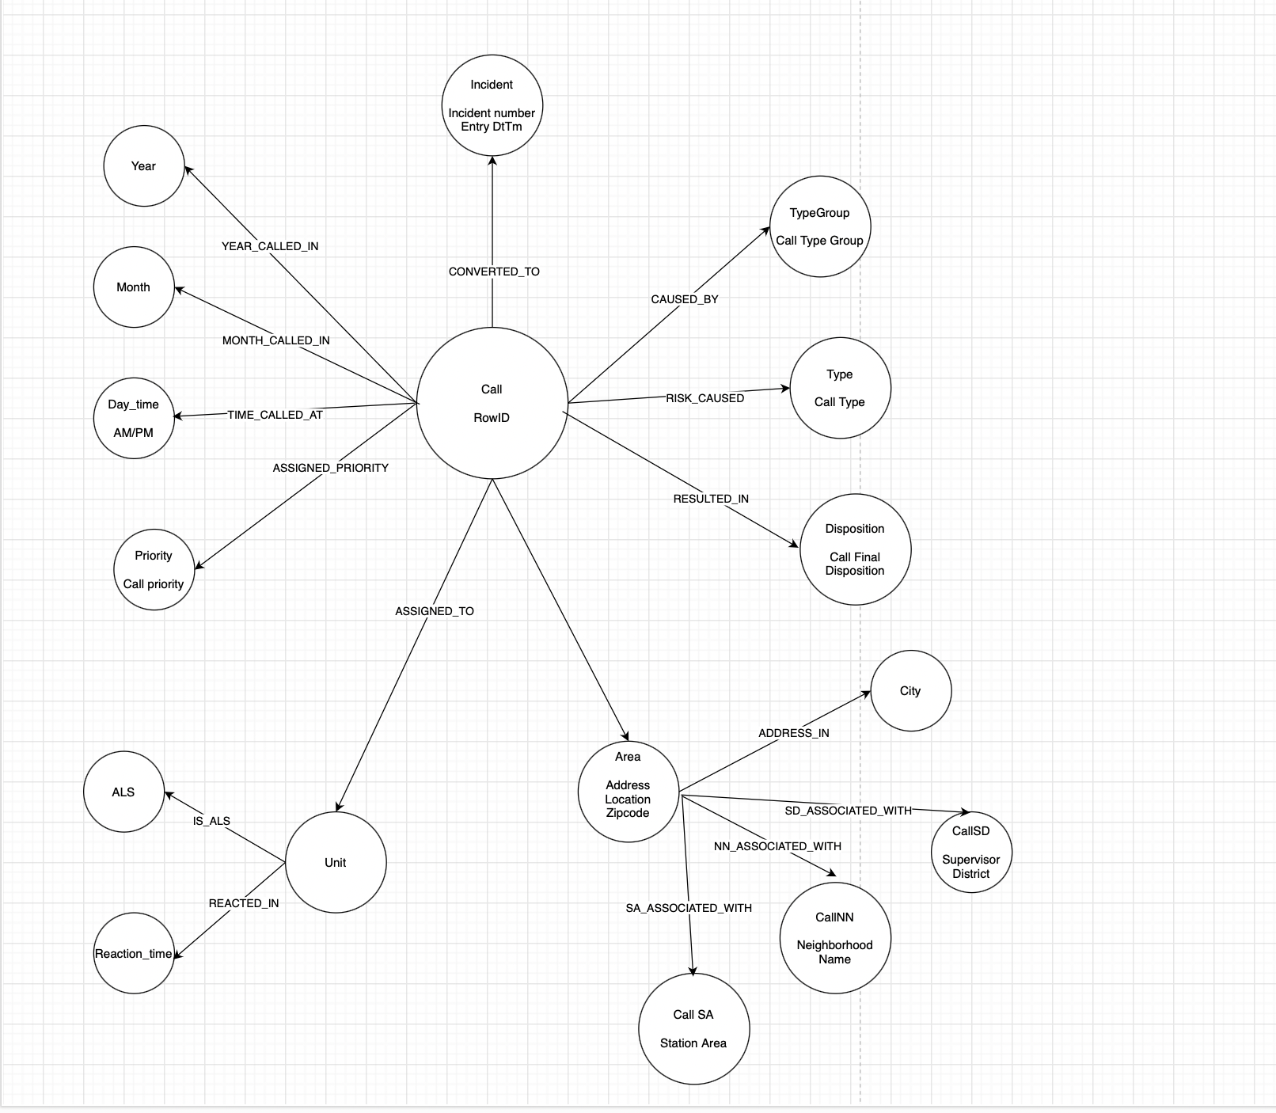
Data Model
Logical implementation of initial Data Model was in draw.io
Physical implementation of Data Model was in Neo4j

Slide 10
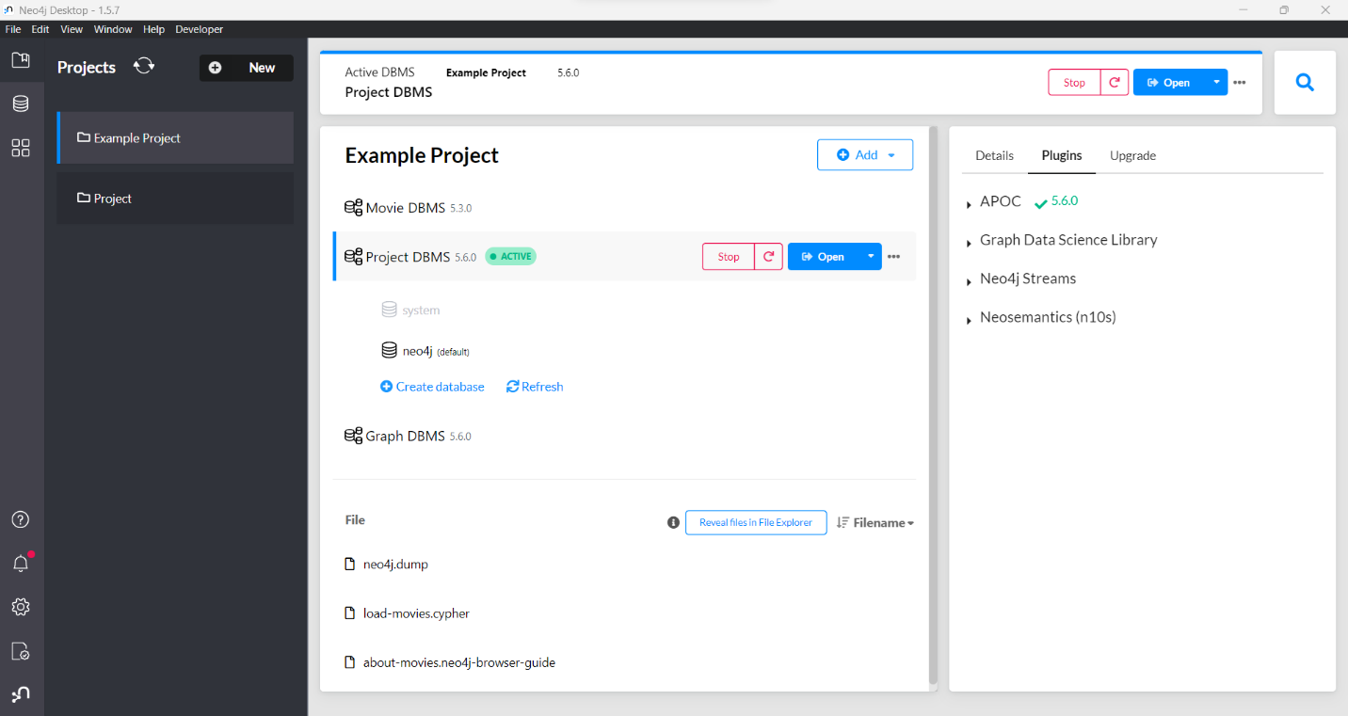
Data Loading
Neo4j Database
The Neo4j database is a type of database that organizes data as graphs, providing reliable data integrity and following the ACID principle. Used Neo4j 1.5.7

Slide 11
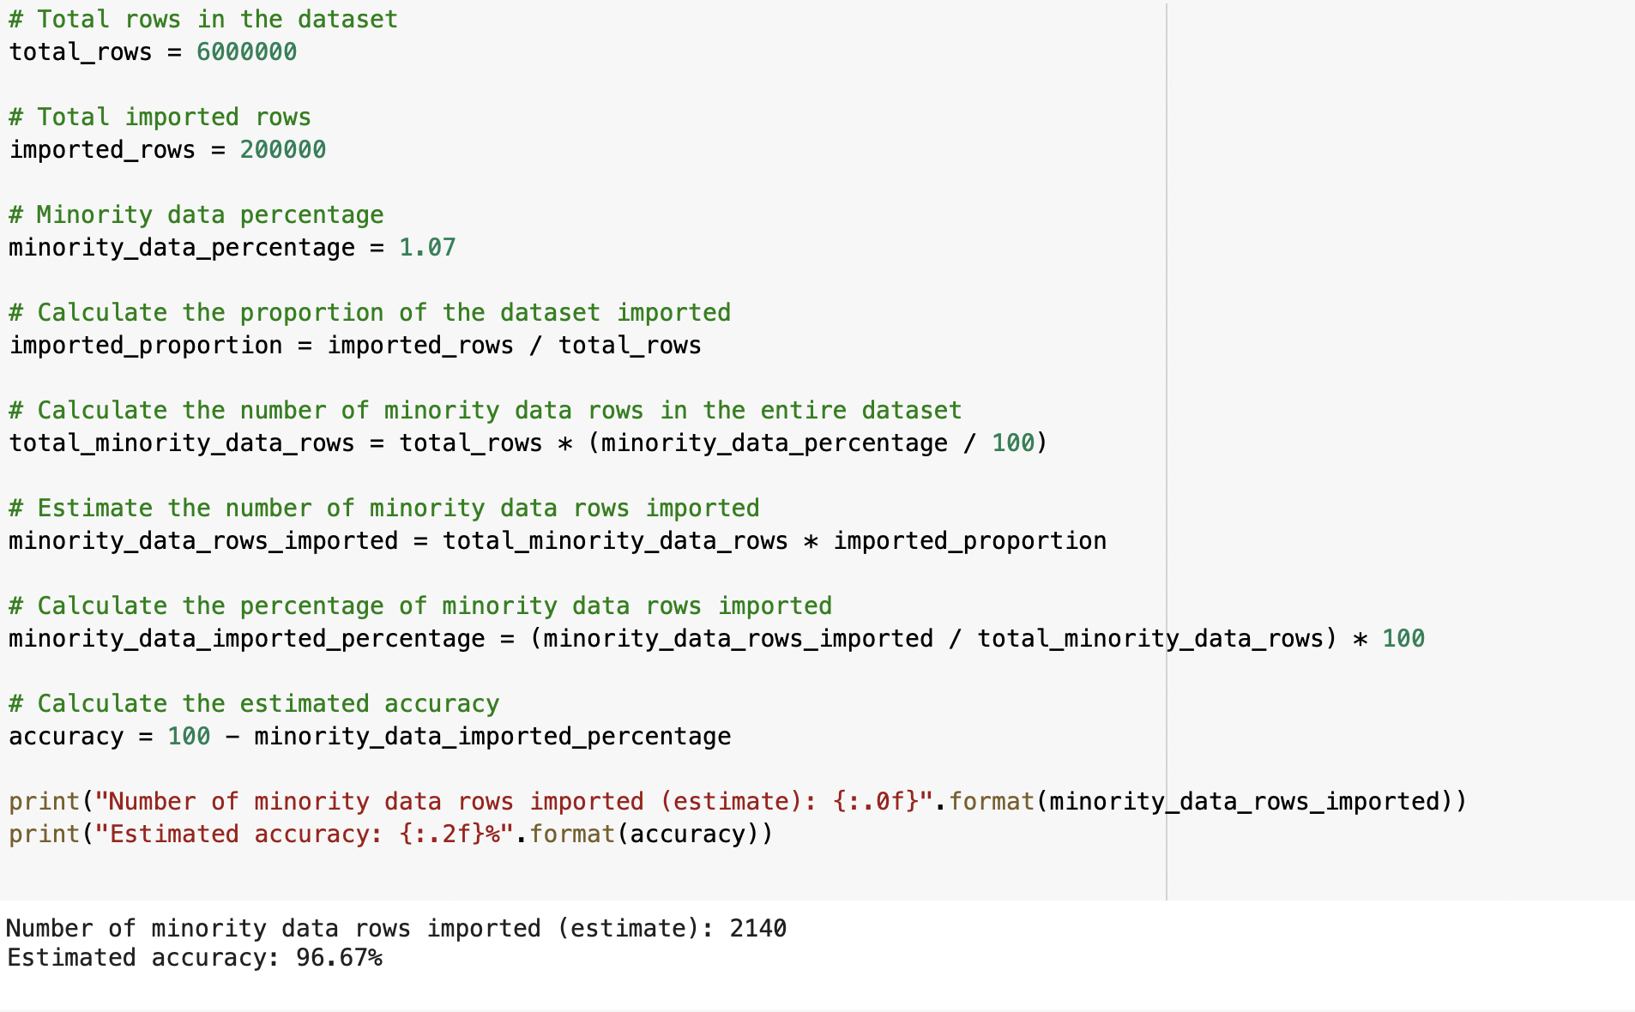
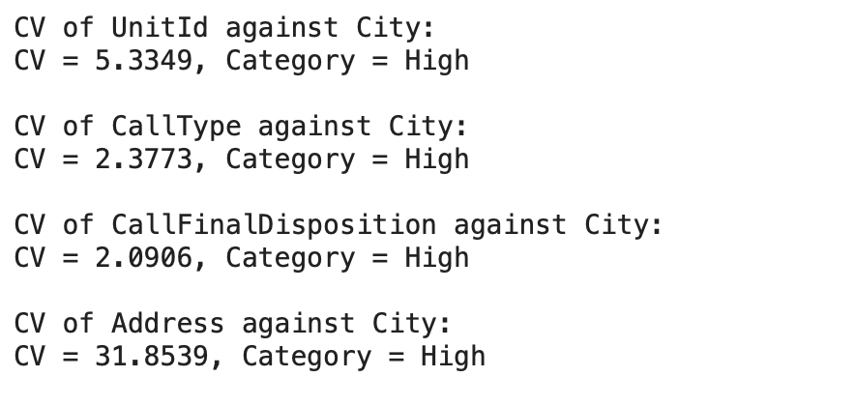
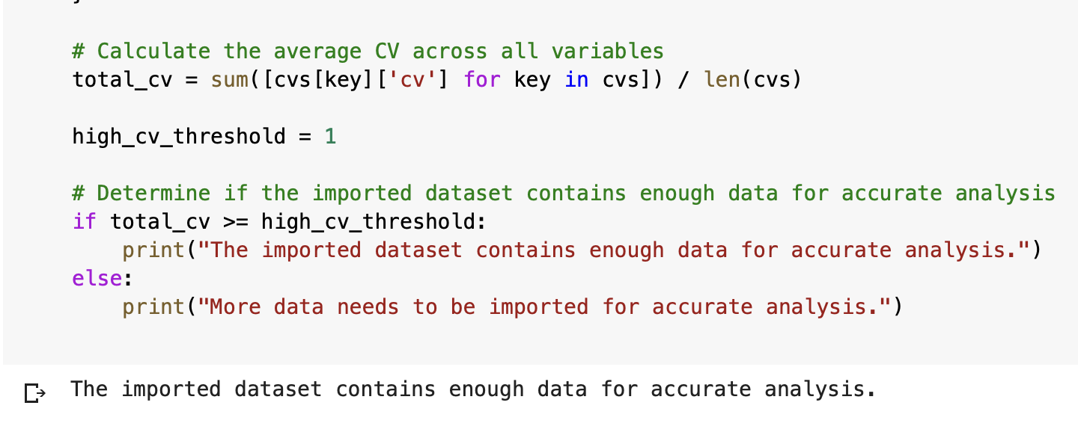
Bias – Variance Analysis
Performed Bias Variance Analysis on the dataset using random shuffling.
Using the minimum percentage of data that needs to be consumed across all variables to achieve higher accuracy, it can be concluded that the dataset does not need to be consumed entirely.
This means that the analysis can be conducted on a smaller sample of the dataset achieving the same amount of accuracy, which can help in reducing computational costs and processing time.

Slide 12
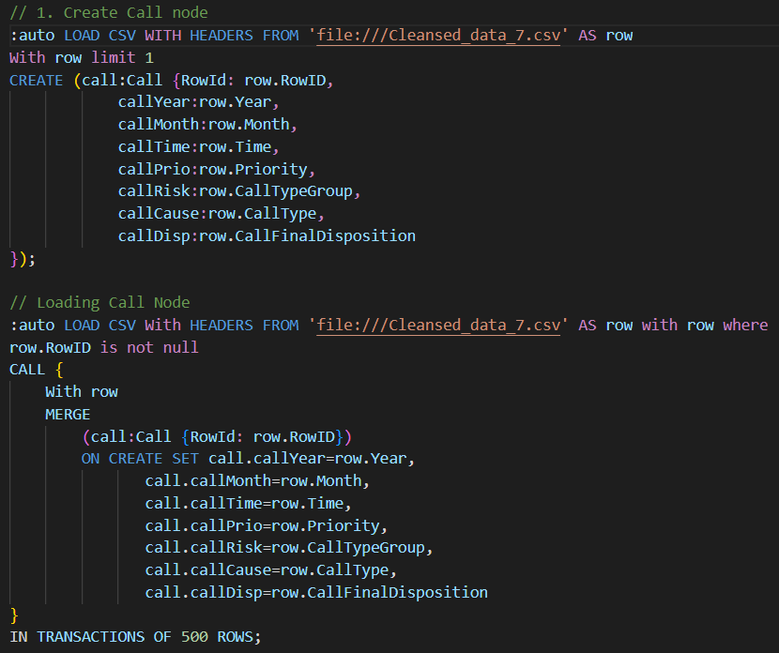
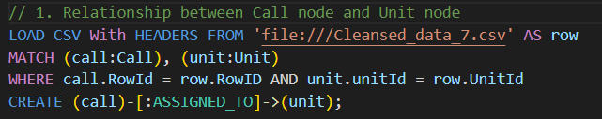
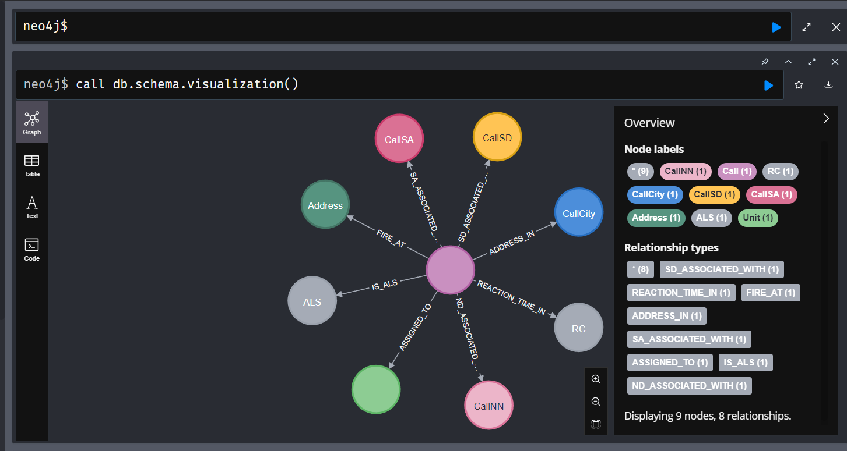
Data Mapping

Slide 13
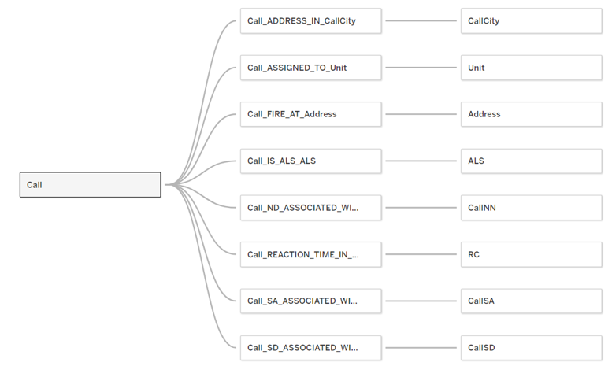
Data Visualization
As a leading data visualization tool, Tableau has many desirable and unique features. Its powerful data discovery and exploration application allows you to answer important questions in seconds.

Slide 14
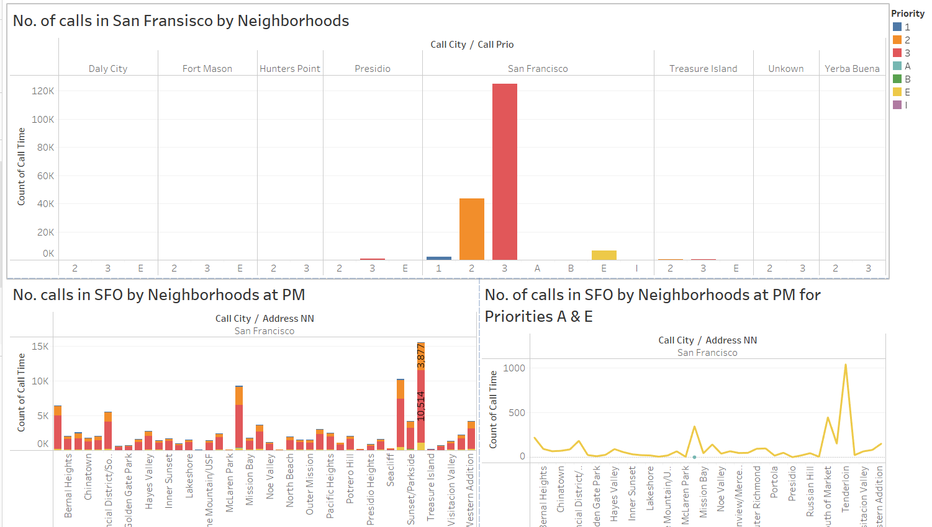
Data Visualization - 1
Number of calls in San Francisco by Neighborhoods:

Slide 15
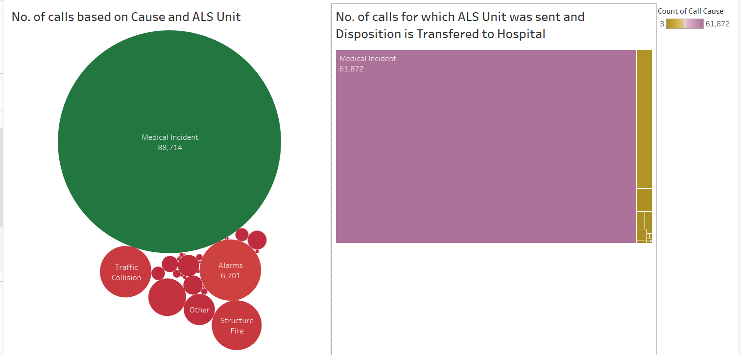
Data Visualization - 2
Which cause of incident is the most common?

Slide 16
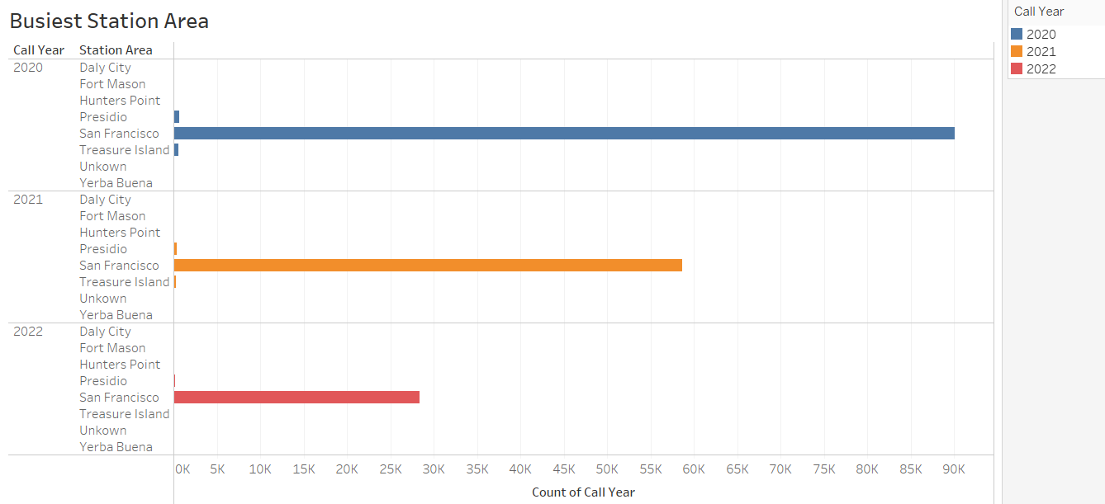
Data Visualization - 3
Which station can expect the greatest number of calls?

Slide 17
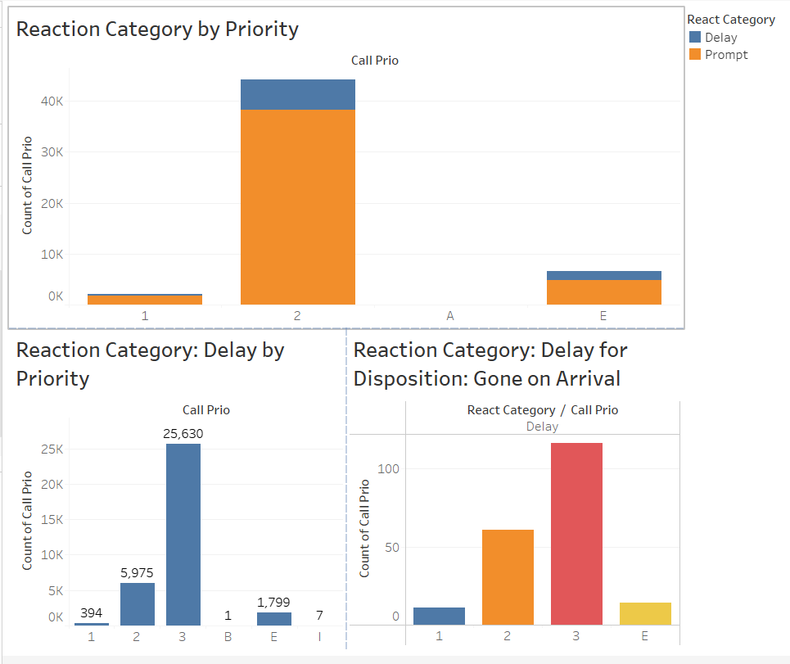
Data Visualization - 4
Reaction times by calls of different priorities for disposition “Gone on Arrival”:

Slide 18
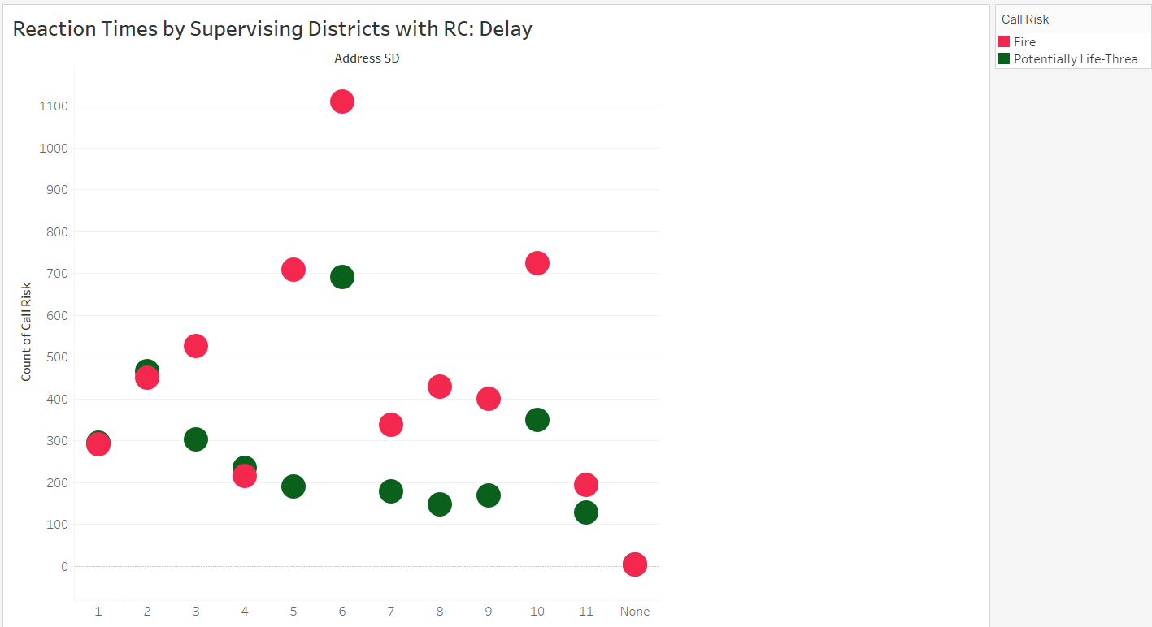
Data Visualization - 5
Reaction times by different supervising districts:

Slide 19
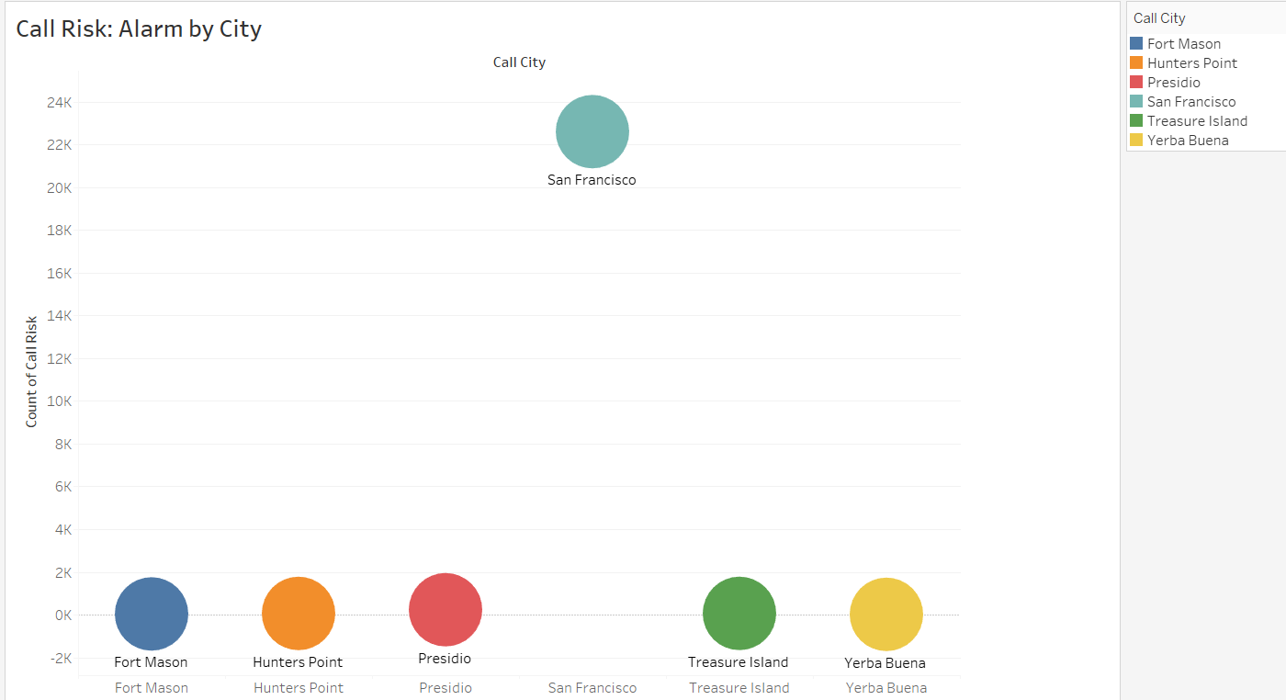
Data Visualization - 6
Which city has the greatest number of call risk: Alarm?

Slide 20
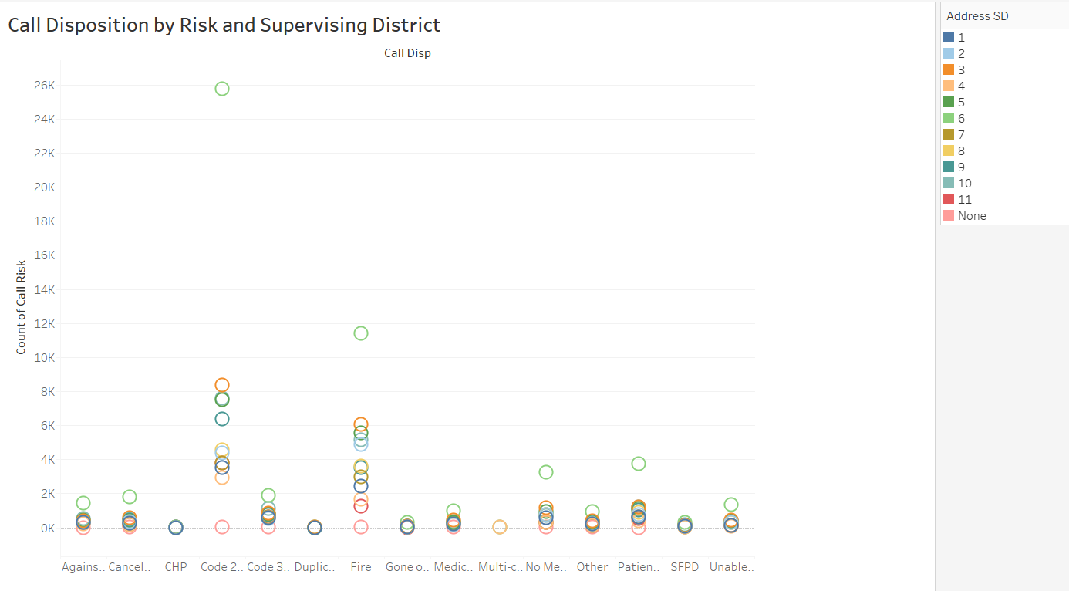
Data Visualization - 7
Distribution of call disposition by risk and supervising district

Slide 21
Conclusion
Visualizations aided in understanding about where:
San Francisco emergency response teams
can find areas of preparedness
areas of resource allocation
areas for improvement
San Francisco emergency units can
implement education initiatives to make the citizens aware of basic knowledge
functioning of their alarm systems.
Challenges encountered:​
Lack of expertise in Neo4j and understanding cypher queries​
Compatibility and interfacing issues​
Data Loading Issues

